Slide 1


General Biology lab
Al-Karkh University for Science
Collage of Science
Microbiology Department
Dr. Rawa Abdul Redha Aziz
Ph.D Antibiotics/ Molecular biology
Laboratory Staff:
1. Lecturer Dr. Rawa Abdul Redha Aziz
2. L. assistant Sura Alaa Saud
3. L. assistant Gada Readh
Supervised by:
1. Prof. Munira Ch. Ismaeel
2. Ass. Prof. Israa AJ Ibrahim

Slide 2
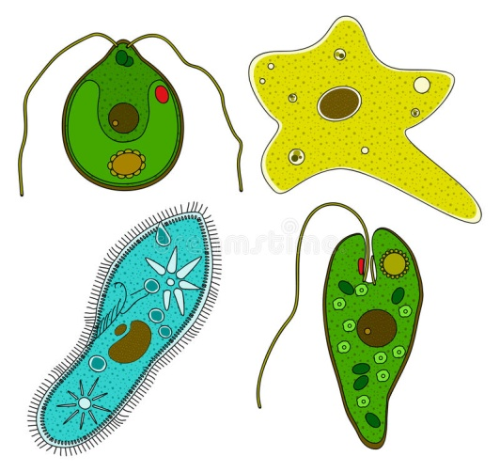
lab 11: Protozoa

Slide 3
They are a large group of single-celled, usually microscopic, eukaryotic organisms, such as amoebas, ciliates, flagellates, and sporozoans. The characteristics of these microorganisms are:
Microscopic organisms
Eukaryotic unicellular
Small size: 10 to 52 µm
No cell wall
Mostly heterotrophic
Very dependent on moisture
Mostly motile with flagella, cilia or amoeboid
Similar to animal (mobility and heterotroph), only unicellular
Protozoa depends on: pH, temperature, nutrition and some depends on sunlight
Habitat: they can grow in marine habitat, fresh water, soil, mosses or symbiotic, or parasites in other organisms (most protozoa are parasites)
Feed by:
Osmotrophy
Phagocytosis
Cytostome
Reproduction in these organisms varies, but most genera reproduce either asexually or sexually.

Slide 4
The importance of protozoa are:
Some protozoa are an important food source for microinvertebrates
They control bacteria populations and biomass to some extent
They can stimulate decomposition of organic matter
They can play a role in nutrient mobilization

Slide 5
The protozoa are classified into four classes on the basis of the structures they possess for locomotion:
Class | Locomotion structure | Example
Mastigophora | Flagella whip-like structures | Euglena
Ciliate | Cilia hair-like structures | Paramecium
Sarcodina | Pseudopodia foot-like structures | Amoeba
Sporozoa | Non-motile without locomotion structure but move by gliding | Plasmodium

Slide 6
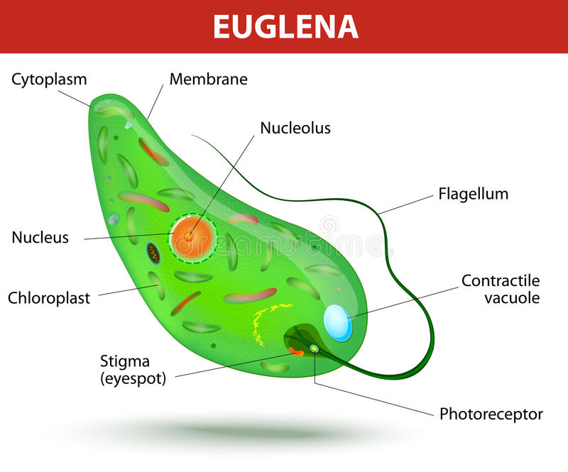
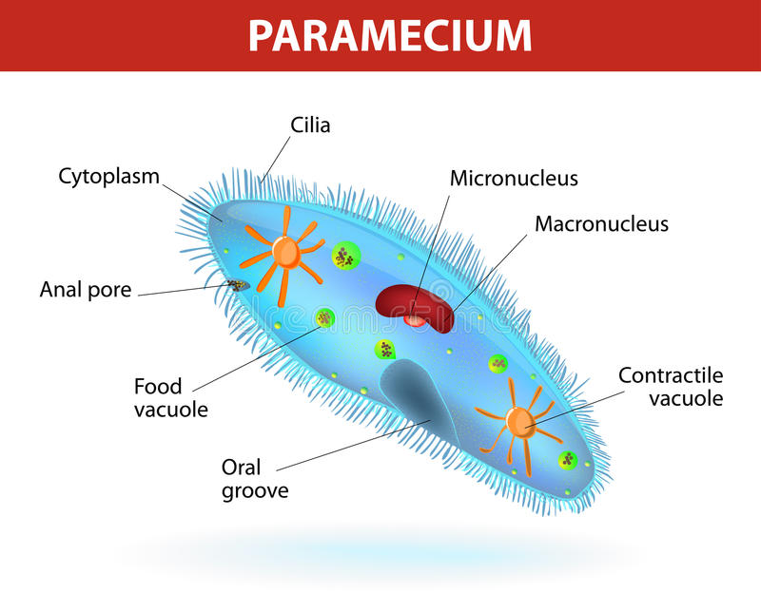
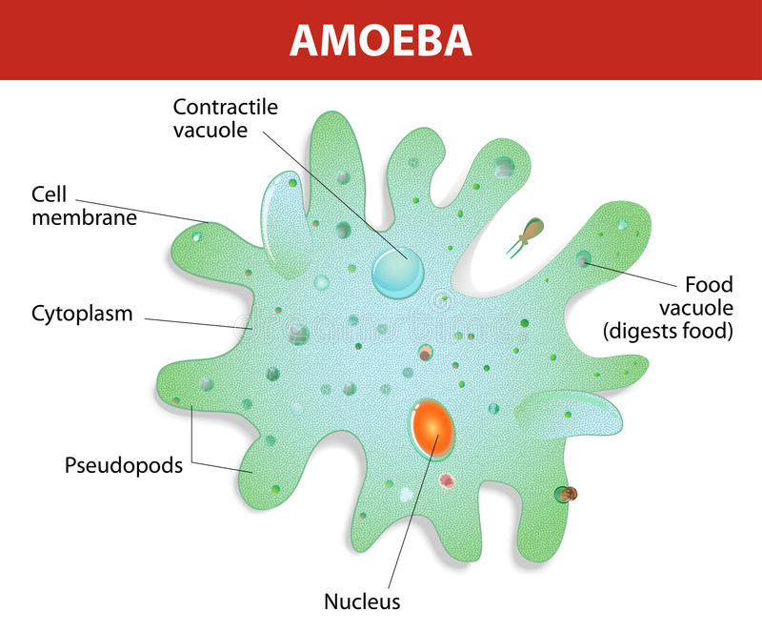
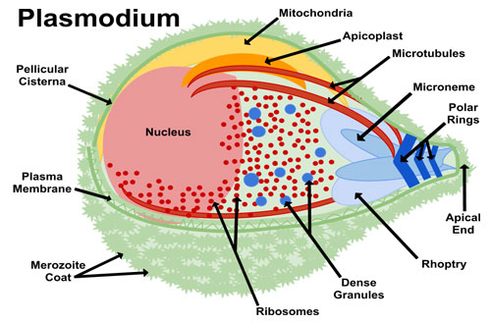

Slide 7
Examples of major pathogenic protozoa
Source | Diseases | Protozoan
 |  | Amoeboid protozoa
Humans, water and food | Amoebiasis (intestinal and other symptoms) | Entamoeba histolytica
 |  | Ciliated protozoa
Pigs, cattle | Balantidiosis (intestinal and other symptoms) | Balantidium coli
 |  | Flagellated protozoa
Animals, water and food | Giardiasis (intestinal distress) | Giardia lamblia
 |  | Nonmotile protozoa
Human, vector-borne | Malaria (cardiovascular and other symptoms) | Plasmodium vivax

Slide 8
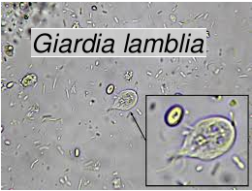
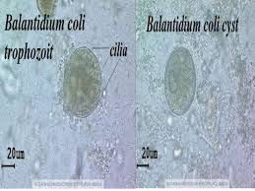
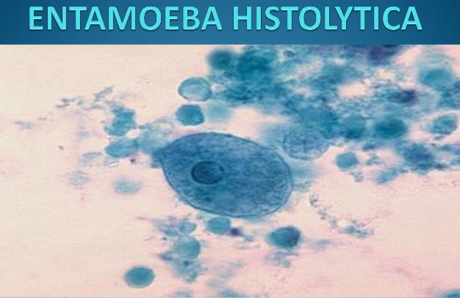
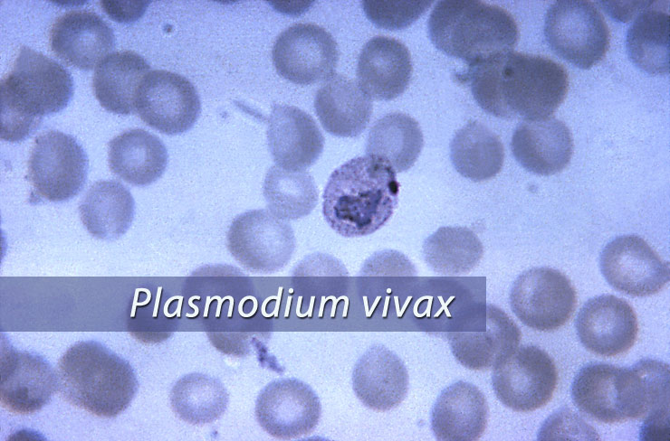

Slide 9
Malaria parasites are micro-organisms that belong to the genus Plasmodium. There are more than 100 species of Plasmodium, which can infect many animal species such as reptiles, birds, and various mammals. Four species of Plasmodium have long been recognized to infect humans in nature.

Slide 10
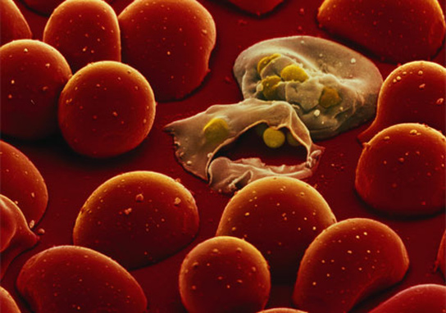
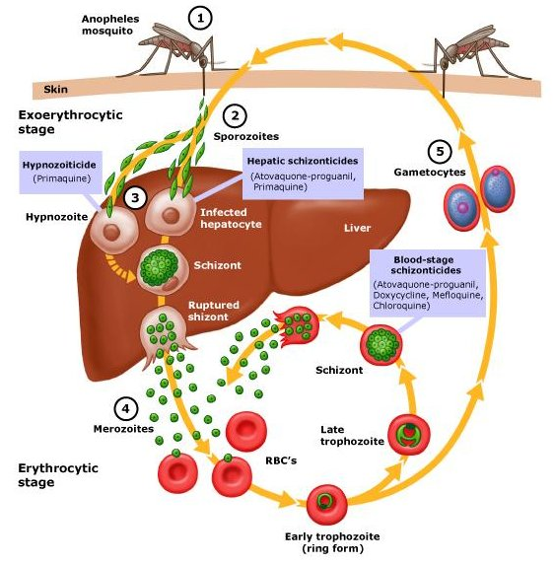
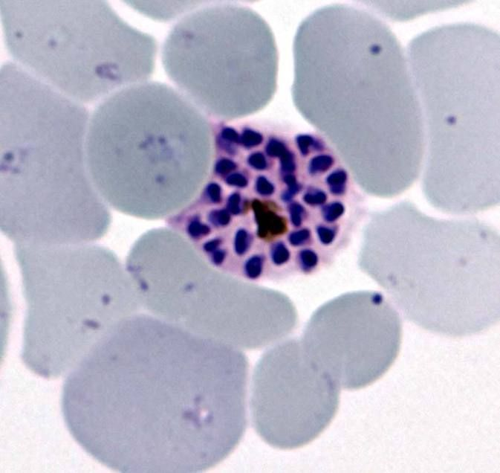
Malaria parasite life cycle

